Slide 1
Angular JS with WebAPI
Authored by: Shitalkumar | Presented by: Shitalkumar

Slide 2
Angular JS with Web API
  Part - II
  Agenda:
    Web API Introduction
    Web API call using Angular JS
    $http service
    $resource service
    oData Service
    Error handling and validation
    When to recommend
    Pros and Cons
    Q&A

Slide 3
Web API Introduction
Web API
RESTful Web API
Resource | Verb | Expected Outcome | Response Code
/Products | GET | A list of all products in the system | 200/OK
/Products?Colour=red | GET | A list of all products in the system where the colour is red | 200/OK
/Products | POST | Creation of a new product | 201/Created
/Products/81 | GET | Product with ID of 81 | 200/OK
/Products/881(a product ID which does not exist) | GET | Some error message | 404/Not Found
/Products/81 | PUT | An update to the product with an ID of 81 | 204/No Content
/Products/81 | DELETE | Deletion of the product with an ID of 81 | 204/No Content
/Customers | GET | A list of all customers | 200/OK

Slide 4
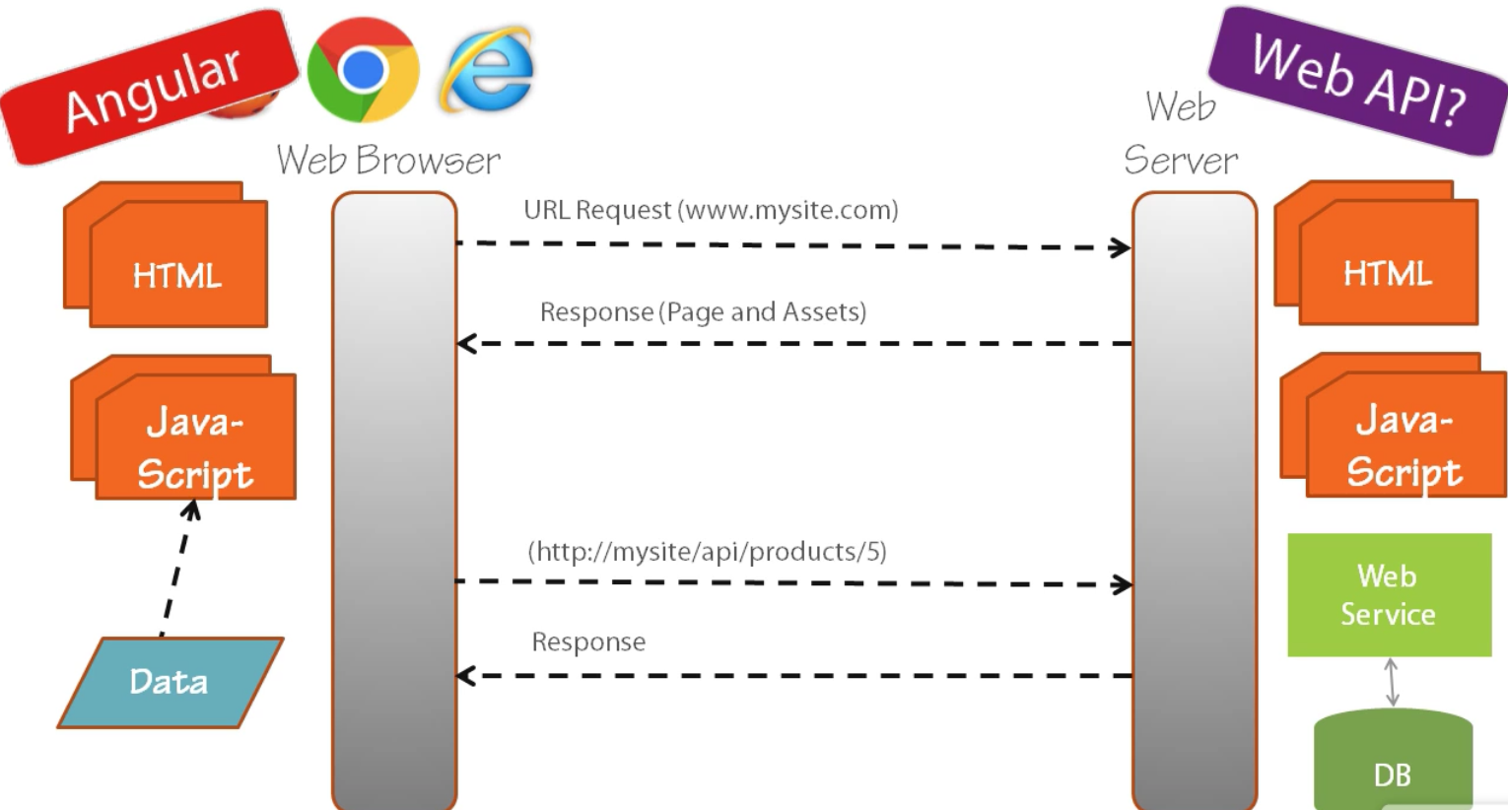
Web API call using Angular JS
  Retrieve data(GET)

Slide 5
Angular Services for calling web service
  1. $http
  Get:
  Put:
      $http.put(url, data, config)
      .success(function (data, status, headers, config) {
      })
      .error(function (data, status, header, config) {
      });
  Post:
      $http.post(url, data, config)
      .success(function (data, status, headers, config) {
      })
      .error(function (data, status, header, config) {
      });
  Delete:
  $http.delete(url, data)
  .success(data, status, headers, config)
  .error(data, status, headers, config);
  Sample(Get - Filters.html and for Put,Post,delete –httpMethods.html)…

Slide 6
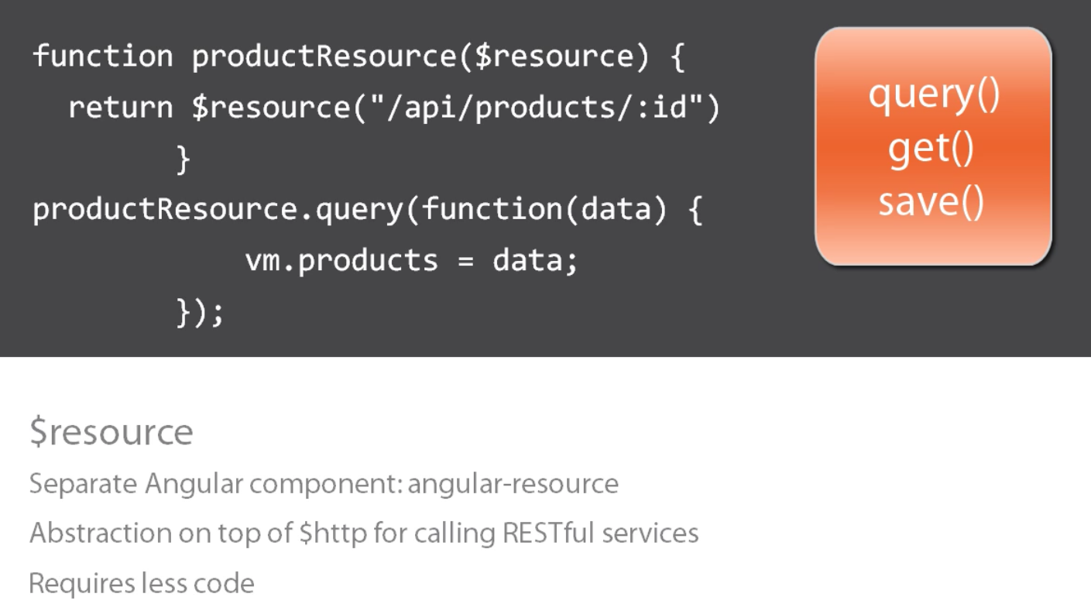
Angular Services for calling web service
  2. $Resource
  Sample(GetResource.html)…

Slide 7
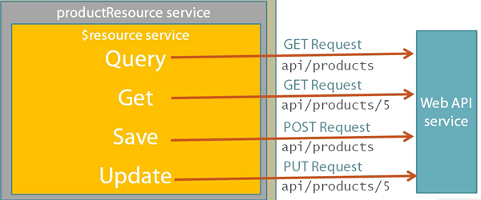
Web API call using Angular JS
  Saving Data using PUT/POST
  Sample(editPage.html)…

Slide 8
Web API call using Angular JS
The result of the function call is a resource class object which has the
following five methods by default:
get() – use this to get specific record. used to invoke GET method
query() – use to get array list. used to invoke GET method
save() – use this for POST/saving data. Need to call on model to POST with $save
delete() / remove() – use to delete record. Both delete and remove are same methods used to call DELETE action. We need to define custom delete method to perform DELETE action.
update – To support an update operation we need to modify our custom factory Entity. We need to define custom update method for performing PUT action.

Slide 9
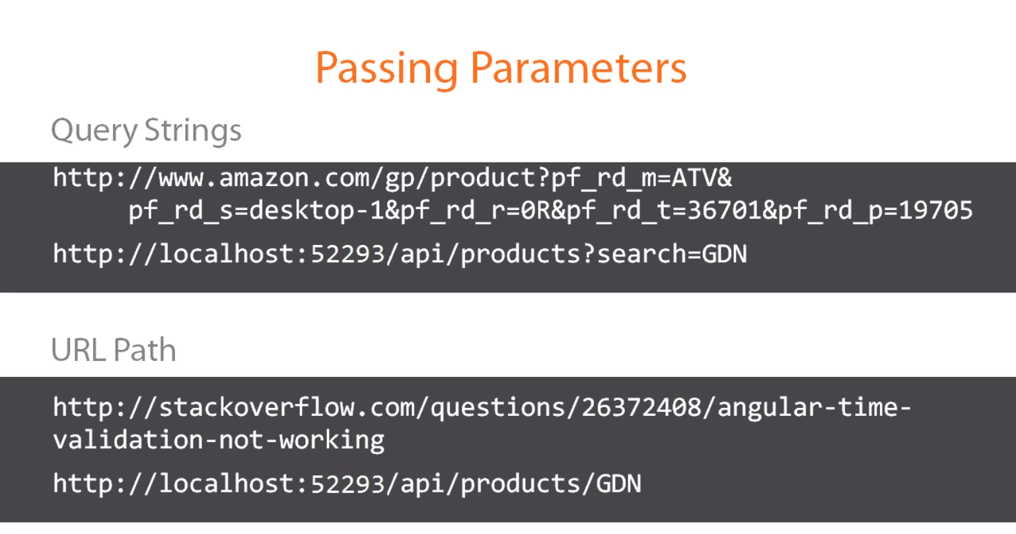
Web API call using Angular JS
  Sample(GetResource.html for Querystring and URL Path)…

Slide 10
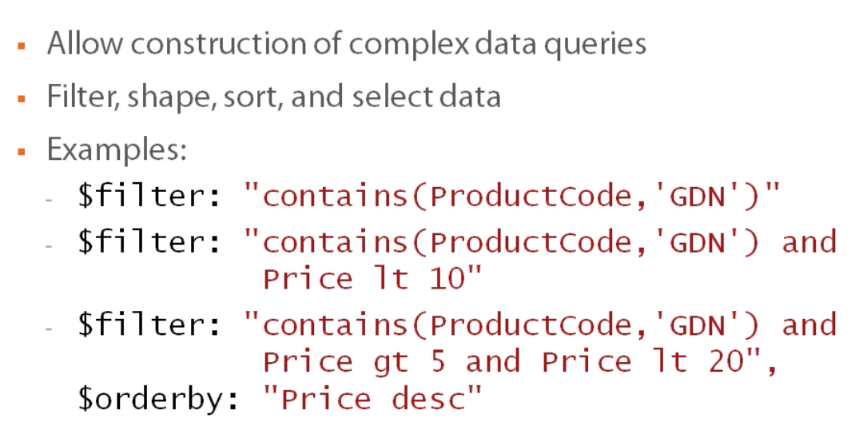
Web API call using Angular JS
  oData Service call

Slide 11
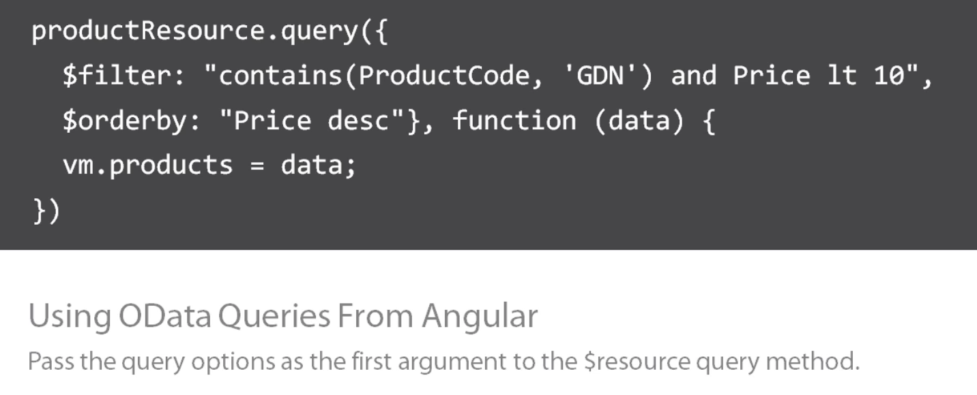
Web API call using Angular JS
  Angular call to oData service

Slide 12
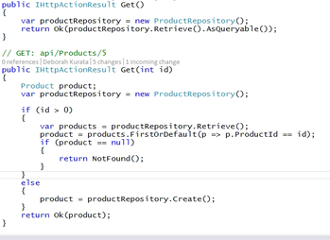
Error handling
  Action Results – Server

Slide 13
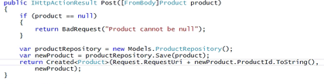
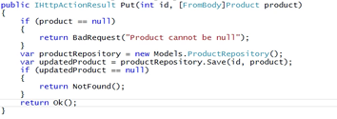
Error handling
  Action Results – Server

Slide 14
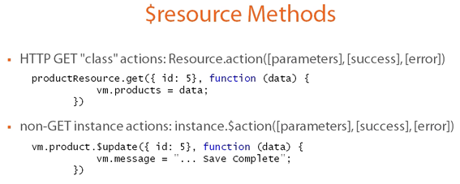

Error handling
  Action Results – Client

Slide 15
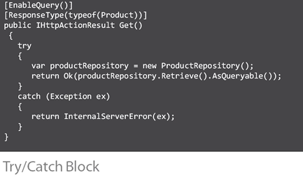
Error handling
  Error Handling(Server)

Slide 16

Error handling
  Error Handling(Client)

Slide 17
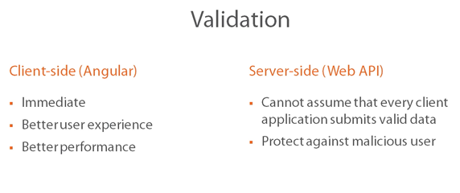
Error handling

Slide 18


Error handling
  Validation - Client Side(Angular)

Slide 19
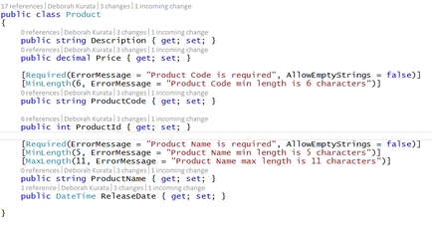
Error handling
  Validation – Server Side(Web API)
  Step1

Slide 20
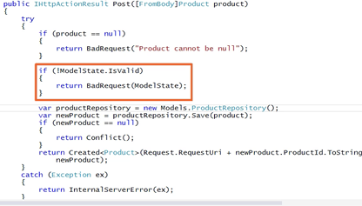
Error handling
  Validation – Server Side(Web API)
  Step2

Slide 21
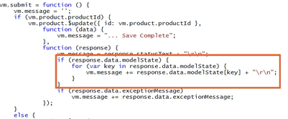
Error handling
  Validation – Server Side(Web API)
  Step3

Slide 22
Pros and Cons
  Pros
    Achieve more with less coding efforts
    Angular features like SPA, data binding, routing, dependency injection, directives, services etc.
    Develop web application with less effort and easy for unit testing.
    Developed by Google
    Large community support
  Cons
    Large file size
    Difficult to integrate into 3rd party services
    Angular is a very big codebase. If you need to extend the base functionality, or look into the internals, or debug deep into the framework, it is much harder to comprehend than other frameworks
    Angular way coding and less scope for customization.

Slide 23
References
Documentation at : https://angularjs.org
http://www.asp.net/web-api/
Youtube Video: angularjs by Dan Wahlin
Plural Site:
  Angular JS – Getting Started
  Angular Front to Back with Web API
  Angular Line of Business

Slide 24
Any Questions?
Have a question now?
 Just ask!
Think of a question later?
shitalkumard@Cybage.com
 8403

Slide 25
Thank you!

